Slide 1
Network Switch Caching
Elliot Carr-Lee & Jake Pitkin

Slide 2
Introduction
A major challenge of scaling a key-value store across a storage cluster is coping with skewed, dynamic workloads.
”Hot items” leave servers either over- or under-utilized and throughput and response times suffer.
NetCache is a key-value store architecture that leverages the power and flexibility of new-generation programmable network switches.

Slide 3
Approach
10% of items account for 60-90% of queries in the Memcached deployment at Facebook.
Exploit the theoretical result that caching O(N log N) items is sufficient to balance the load for N storage servers (or CPU cores) across the entire hash-partitioned key-value storage cluster, regardless of the number of items stored in the system.
Goal: cache the O(N log N) hottest items in the network switch to give a high probability that no server with experience more than T load where N * T is the total network load.
Notes:
Switches have small on-chip memory but are optimized for data input-output.
It uses switches as a load-balancing cache with medium cache hit ratio (<50%).

Slide 4
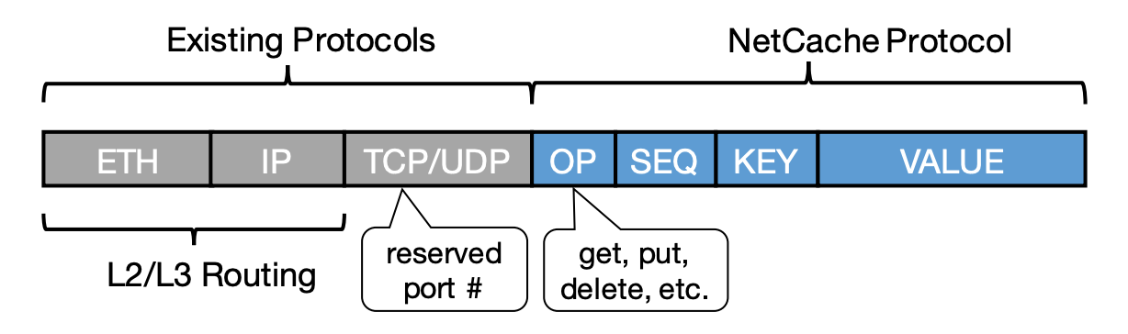
Network Design
NetCache is an application-layer protocol embedded inside the L4 payload.
UDP for read queries (low latency)
TCP for write queries (reliability)
NetCache switches are placed on the path from the clients to the storage clusters. Existing routing protocols are used to forward packets.

Slide 5
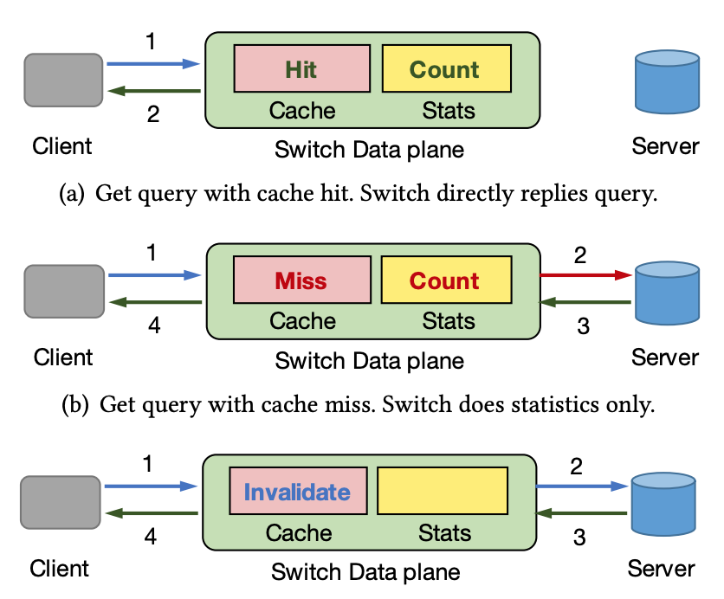
Query Handling
Read (hit): Switch directly replies to the query and never and never contacts the storage cluster.
Read (miss): Route to the storage cluster and reply to client and update statistics (don’t cache).
Write: Invalidate the cache (if present), forward the query to the storage cluster, update, and reply to the client.
Uses write-through to guarantee cache coherence and handle switch failure.

Slide 6
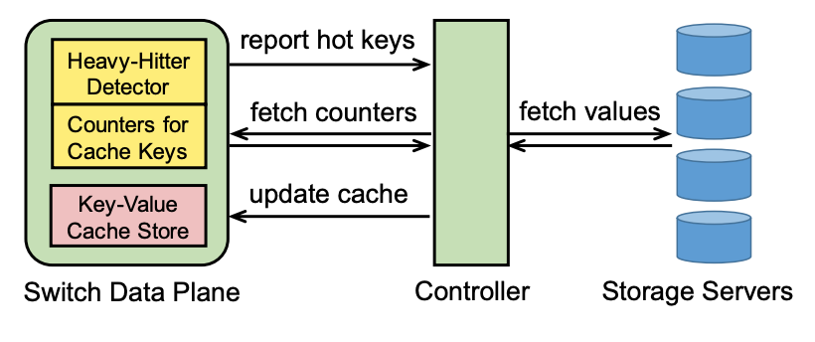
Caching Statistics
Per-key counters for the cached items.
Heavy hitter detector
Uses a Count-Min sketch.
Sends reports to the controller on how to
update the cache.
A bloom filter is used to remove duplicates in the report.
The controller samples a few keys from the cache and compare their counters with the heavy hitters in the report for efficiency.
These are space-efficient data structures that can be implemented in the network switches with minimal hardware resources.

Slide 7
Performance and Limitations
NetCache improves the throughput by 3-10X and reduces the latency of up to 40% of queries by 50%.
NetCache is able to run on programmable switches at line rate—i.e., processing 2+ billion queries per second for 64K items with 16-byte keys and 128-byte values on a single switch.
Does not handle handle highly-skewed, write-intensive workloads.
If more than 20% of the queries are writes similar or worst to not using NetCache.

Slide 8
Theorem
Claim: You can prevent adversarial attacks on a cluster of N servers with a cache whose size is proportional to NlogN
R := The total number of requests the adversary can make to attempt to overload the cluster
X := The total number of distinct keys the adversary targets in their attack
C := The total size of the cache protecting the server

Slide 9
Optimizing X Given C
No Cache: X = 1: The attacker sends R requests to a single key, overloading whichever server it happens to be on.
Cache of size C: X > C: Attacker must spread its attack over at least C+1 keys to get paste the cache at all. It turns out the optimal X is approximately 2C.
R[Xn] = R/X: The optimal strategy is to spread its attack evenly across all X keys. If any one of the targeted keys has a greater proportion of the requests it will be cached, hence wasting any requests greater than the average.

Slide 10
How to Determine X?
The larger X is, the smaller the proportion of requests are handled by the cache. If X = 10C, 9/10 of your total requests make it past the cache.
The larger X is, the less likely it is that its randomly chosen keys will bunch up on any given server. It is assumed that the adversary doesn’t know where given keys are stored so it has to pick keys at random to attack.

Slide 11

Balls in Bins
If the total number of requests that gets past the cache
(M = X-C) is greater than NlogN, then the proportion of requests that land in any server is bounded by:
With high probability. a is a constant that effects the degree of certainty.

Slide 12
Choosing Cache Size C
If I choose a C of at least NlogN, this forces the adversary to choose an X >= 2NlogN or less than half his total requests get by the Cache.
But because he is sending NlogN attacks past the cache, they will be evenly distributed between the servers and no hot keys will occur.
C = 8*NlogN guarantees with high probability that the overheated nodes only get 20% more requests than average.

